Slide 1
MANAGING UNCERTAINTY
October 2015

Slide 2
State Tax Revenue is Slow to Recover From Recession
Inflation-adjusted, 1Q 2015
Percent
4.0%
-12.9%
2006 | 2007 | 2008 | 2009 | 2010 | 2011 | 2012 | 2013 | 2014 | 2015
pewtrusts.org/fiscal-health
Notes:
If you don’t account for inflation, total state tax collections -- that is for all 50 states combined -- made up their losses from the recession at the beginning of 2012. But you get a different perspective when you look at inflation-adjusted dollars. This gets at how much purchasing power a state has.
To do that, we first identified each state’s own peak quarter for tax collections before receipts fell in the economic downturn. We also did that for tax revenue for all 50 states combined. Then, for each quarter, we measure how far above or below tax revenue is from that peak.
Nationally, total tax revenue for the 50 states combined peaked in the third quarter of 2008, a few months into the recession. It then fell for five straight quarters, bottoming out at 12.9% below peak at the end of 2009. From there, it took 14 straight quarters of growth for tax revenue to finally surpass its 2008 level. It edged above the zero line for the first time in the middle of 2013.
The graph ends in the first quarter of 2015, when quarterly tax revenue was 4.0 percent above its previous peak, after adjusting for inflation. Our data come from the Rockefeller Institute of Government, which adjusts data from Census.
Another way of thinking about this is that for every $1 states collected at their peak in 2008, taking inflation into account, they took in about 87 cents at the low point in 2009. And of late states were taking in four cents more for every $1 they took in almost six years earlier. Which doesn’t leave states much to make up for population increases, growth in Medicaid enrollment, deferred needs, accumulated debts, or other needs that put additional strain on state budgets.
The economy drove a lot of this growth. Policymaking played a role, too, because a number of states raised taxes since the recession. And, some of the growth in 2013 was the result of taxpayer behavior in response to changes in the federal tax code. [State income tax collections in 2013 were higher than expected because a number of taxpayers accelerated capital gains and other income into 2012 to avoid higher federal rates that were about to take effect. As a result, state coffers saw a one-time jump in receipts when tax bills were paid in 2013. Consequently, some states that based revenue projections on their higher 2013 levels saw larger-than-expected declines in income tax revenue in April 2014]
[In nominal dollars, 44 states have surpassed their peak (4Q MA). The 6 still lagging are: New Jersey, Ohio, Florida, Louisiana, Wyoming, and Alaska. The 50-state total surpassed its peak in nominal terms in the first quarter of 2012.]
But while state tax revenue has recovered on a national basis, the recovery has been quite uneven across the states.

Slide 3
Florida’s Decline During Recession
Inflation-adjusted, 1Q 2015
Percent
-18.0%
-27.0%
RECESSION
2006 | 2007 | 2008 | 2009 | 2010 | 2011 | 2012 | 2013 | 2014 | 2015
Notes:
For example, let's look at Florida. Its economy was hit hard by the housing bust. Home prices plummeted and its foreclosure rates were among the highest in the nation^{[i]}.” The blue line is the 50-state total. As you can see here in orange, Florida’s tax collections actually peaked in 2006, before the Great Recession even began. Florida's tax collections soon fell below the 50-state benchmark and are still below. At its depths, Florida’s tax revenue fell to 27 percent below that peak.
(The state experienced the fourth “deepest dip” after the recession – behind AK (75), WY (30.4), and LA (27.0).
And state tax collections were still 18.0 percent below peak as of March 2015. Only Alaska (-82.7%) and Wyoming (-19.9%) were still farther behind where they once were in tax collections.
^{[i]} https://www.moodys.com/researchdocumentcontentpage.aspx?docid=PBM_PBM146418

Slide 4
Smallest Decline During Recession
Inflation-adjusted, 1Q 2015
Percent
8.3%
-4.0%
RECESSION
2006 | 2007 | 2008 | 2009 | 2010 | 2011 | 2012 | 2013 | 2014 | 2015
Notes:
Contrast that with a state like Arkansas (seen here in green). It saw its revenue dip the least of any of the 50 states. At its lowest point, its inflation-adjusted tax collections dropped 4 percent in the third quarter of 2009. And its tax revenue was fully recovered midway through 2011 and is now 8.3% above peak. The state has consistently performed better than the 50-state total.
The state has a law that automatically triggers spending cuts when revenue projections are reduced.
“The state's economy benefits from the presence of Wal-Mart's headquarters (the company is the state's largest employer) and steady net migration from other states.”
Fiscal 50 shows results like these for each state. Pew will update these data with each new quarter of Census data on state tax revenue.
Now, to answer my question: have states recovered? As Florida and Arkansas illustrate, it matters where you live.
In fact, the majority of states have not yet gotten back to where they were.
https://www.moodys.com/research/Moodys-assigns-Aa1-ratings-to-30-million-of-Arkansas-GO-New-Issue--NIR_901531316

Slide 5
Alaska and North Dakota Tax Revenue
Inflation-adjusted, 1Q 2015
Percent
119.0%
-13.7%
-82.7%
RECESSION
-69.0%
2006 | 2007 | 2008 | 2009 | 2010 | 2011 | 2012 | 2013 | 2014 | 2015
Notes:
For example, if you were from North Dakota (shown here in orange), you would be riding the state’s oil boom to a revenue high. North Dakota led the nation with tax revenue now at 119.0 percent above its highest point during the recession.
As severance and sales taxes have grown, the state has cut income and property taxes.
Farthest below peak is Alaska – here in green - down 82.7 percent from its high mark. Now, Alaska is also an oil-rich state. But if you were from Alaska, you would understand that the state’s revenue peak in 2008 was artificially high. The peak resulted when crude prices spiked to an all-time high just as a state windfall profit tax took effect.

Slide 6
State Tax Revenue Recovers
Slowly and Unevenly
Inflation-adjusted, 1Q 2015
Below -15%
-15% to 0%
0% to 15%
Above 15%
Notes:
This is the standing according to the latest 50-state data. At the beginning of 2015 tax revenue was back up to its prior peak level in 23 states, in inflation-adjusted dollars. It was still running behind in 27 states. Of the 27, 4 states were still more than 15 percent below peak—including Alaska, Florida Louisiana, and Wyoming.
The effects of the recession continue to be felt but it really matters where you live. So, did your state start calendar year 2015 as orange – with less purchasing power than when the recession started? Or did it end blue?

Slide 7
Highest Above Peak and Lowest Below Peak
Inflation-adjusted, 1Q 2015
North Dakota
Illinois
Colorado
Minnesota
50-state
Louisiana
Florida
Wyoming
Alaska
Notes:
There’s also wide variation in how dramatically states were affected.
Here are the bookends when it comes to tax collections since the recession.
It probably doesn’t surprise you that North Dakota led the nation as it rode its oil boom. Its tax revenue is 119.0 percent above its highest point during the recession. But not every state’s revenue increase can be attributed to the economy. In second place was Illinois, which started 2015 up 19.8 percent from its recession peak level. Its revenue was boosted by an income tax increase in 2011.
IL’s income tax increase passed 2011. From 3 to 5 percent for four years, expiring January 1, 2015. IL also has more than $5 b in unpaid bills and pension liabilities.
MN’s revenue had recovered to its post-recession peak before last session. A tax increase in the 2013 session (not sure when it kicked in) raised income taxes for high-income Minnesotans, raised tobacco taxes.
Alaska shows up as farthest from peak -- down 82.7 percent from its high mark. But that is mostly because Alaska’s revenue had a short-lived spike in tax collections in 2008 when crude prices spiked to an all-time high just as a state windfall profit tax took effect.
The bottom line? Clearly the recovery is uneven. The majority of states – 27 in all – started 2015 still behind in tax collections, after adjusting for inflation.

Slide 8
States with Most Volatile Revenue Fluctuations
Fiscal years 1995 to 2014
Notes:
In the first view of Fiscal 50’s revenue volatility indicator, you will see all 50 states ranked in descending order of their overall tax volatility, from greatest to least. In this view, you can quickly compare states’ overall volatility relative to other states. Now, in this slide you can see the four most tax-volatile states in the country, from the top of that 50-state chart, but it’s worth noting that 41 of 50 states have volatility scores ranging between 3 and 7 percent.
To clarify what our calculation means , a volatility score of 11.9, as in Wyoming, indicates that total tax revenues typically fluctuated by 11.9 percent from year to year over the time period. Similarly, we have calculated the volatility of all US state tax revenue, which you can see in the green bar, as a point of comparison.
3 of the 4 states in this graph have a relatively high reliance on revenue from severance taxes on oil and gas extraction. For example, 39 percent of Wyoming’s tax revenues in 2014 came from severance taxes. As I’ll discuss later, this reliance on a particularly volatile tax source is a major reason why the state has one of the highest levels of reserves and balances of any state in the country.

Slide 9
States with Least Volatile Revenue Fluctuations
Fiscal years 1995 to 2014
Notes:
At the opposite end of the spectrum, here are the four least tax-volatile states in the country.
Kentucky has a volatility score of 2.8 percent, meaning revenues typically fluctuated by 2.8 percent from year-to-year. These states had the most stable revenues in the county when adjusted for tax policy changes as a result of the interaction between their particular state tax policies and their unique economic conditions.
For example, Kentucky happens to have some of the least volatile sales tax and personal income tax collections in the entire nation, which results in their low overall tax volatility.

Slide 10
Severance tax most volatile in 6 out of 9 states where it is a major source
Notes:
Along with the overall volatility view, this indicator also shows the year-over-year revenue fluctuations in each state’s major revenue streams from 1995 to 2014, along with the volatility score of each revenue stream. As with all data in this indicator, the impact of known state tax policy changes has been removed.
In the next few slides let me go over a few interesting observations drawn from the data about particular major state tax sources.
In this slide, you can see that severance taxes on natural resource extraction – primarily oil and gas – are the most volatile major tax source in 6 out of the 9 states that have this type of tax.

Slide 11
Severance tax volatility
Montana: Year-over-Year Percent Change of Major Tax Sources
RECESSION
RECESSION
FY
FY
FY
FY
FY
FY
FY
FY
FY
FY
FY
FY
FY
FY 1996
FY 1998
FY 2000
FY 2002
FY 2004
FY 2006
FY 2008
FY 2010
FY 2012
FY 2014
Notes:
In the second view of this indicator, you can examine graphs presenting the year-over-year fluctuations of the major tax streams in all 50 states. Montana is one of those six states where severance collections are the most volatile major revenue source. The bright pink line shows the year over year adjusted change in the state’s severance tax, which had a volatility score of 32.4 percent, which stands in stark contrast to their property, personal income, and motor fuels taxes, with scores that range between 4 to 8 percent.

Slide 12
Corporate income tax most volatile in 25 out of 30 states where it is a major source
Notes:
In this slide, you can see that taxes on corporate incomes were the most volatile tax source in 25 out of the 30 states that levy them as a major tax.

Slide 13
Corporate income tax volatility
New York: Year-over-Year Percent Change of Major Tax Sources
RECESSION
RECESSION
FY
FY
FY
FY
FY
FY
FY
FY
FY
FY
FY
FY
FY
FY 1996
FY 1998
FY 2000
FY 2002
FY 2004
FY 2006
FY 2008
FY 2010
FY 2012
FY 2014
Notes:
New York is one of the states with a corporate income tax that is more volatile than any of its other streams (note its spikes just prior to recessions and dips during and after recessions). Its corporate income tax had a volatility score of 21.8, compared to a score of 8.2 for personal income and 4.6 for sales.

Slide 14
Personal income tax is most volatile in 8 out of 41 states where it is a major source
Notes:
And in this final map, you can see that personal income taxes were the most volatile major tax source in only 8 out of the 41 states that levy them. This is interesting because personal income taxes are frequently a mainstay of states’ tax portfolios, but their volatility ranges dramatically.

Slide 15
Personal income tax volatility
Missouri: Year-over-Year Percent Change of Major Tax Sources
RECESSION
RECESSION
FY
FY
FY
FY
FY
FY
FY
FY
FY
FY
FY
FY
FY
FY 1996
FY 1998
FY 2000
FY 2002
FY 2004
FY 2006
FY 2008
FY 2010
FY 2012
FY 2014
Notes:
Missouri is one of 8 states where personal income was the most volatile tax source. Its personal income had a volatility score of 7.0. Its motor fuels tax had a score of 4.9 and its sales tax had a score of 3.4. Again , this information can be found for every state in the Fiscal 50 indicator.

Slide 16
Federal Share of State Revenue
Hit 50-Year High After Great Recession
FY 2000 to FY 2013
FY2004:
31.3%
FY2013:
30.0%
RECESSION
RECESSION
FY 2001 | FY 2003 | FY 2005 | FY 2007 | FY 2009 | FY 2011 | FY 2013
Notes:
What I’m showing you here is the money that states take in during the year, and calculates what percent of it came from the federal government, through grants and other transfers to state governments. It lets you see how the role that federal funds play in states’ budgets has changed over time, and how the role varies between states.
Here is the trend for federal funds as a share of revenue for all 50 states combined. What we see is that in recessions, the share of states’ money that comes from the federal government tends to rise. That’s both because the federal government has issued temporary economic stimulus aid to the states, and because states’ own revenues have fallen. Over the last 50 years, the federal government has provided on average about one-quarter to one-third of states’ revenue.
Federal funds reached a new record after the latest recession, accounting for more than $1 of every $3 in state revenue. They peaked in fiscal 2010 at 35.5% of state revenue. In fiscal 2013, we see the effects of the expiration of federal stimulus dollars from the American Recovery and Reinvestment Act at the same time that the tax revenue indicator I showed you earlier captures a comeback in states’ own revenues.
Going forward, the Budget Control Act, or sequester, will limit new federal spending in states. Meanwhile the Affordable Care Act also will have a big effect on this ratio, as more Medicaid dollars will go to states that are choosing to expand their Medicaid programs. This will add to the variation we already see in the role of federal dollars in the states.

Slide 17
Greatest and Smallest Shares of
State Revenue from Federal Funds
FY 2000 to FY 2013
MS
42.9%
US
30.0%
ND
19.0%
RECESSION
RECESSION
FY 2001 | FY 2003 | FY 2005 | FY 2007 | FY 2009 | FY 2011 | FY 2013
Notes:
Here are the states where federal dollars make up the greatest and smallest shares of their general state revenue.
The green line shows Mississippi – the state with the highest proportion of revenue from federal dollars, at 42.9 percent in 2013… and in orange, the state with the smallest share at 19.0 percent – North Dakota – a 23.9 percentage point difference.

Slide 18
Federal Funds as a Share of State Revenue
FY 2013
19.0% to 29.9%
30.0% to 39.9%
40.0% to 49.9%
Notes:
Looking at the nation as a whole, we see that there are only two states that get more than 40 percent of their revenue from the federal government – Louisiana and Mississippi. Neither of these states is expanding Medicaid at this time so we may see a shift in this pattern beyond 2014. Federal funds make up 30 to 39.9 percent of state revenue in 28 states and 19 to 29.9 percent in 20 states.

Slide 19
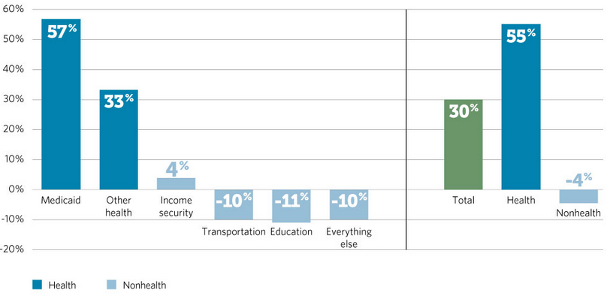
Trends in Federal Grants to States Vary by Program Area
Percentage change from federal fiscal year 2008-15, adjusted for inflation

Slide 20
State Medicaid Spending as a Share of Own-Source Revenue
2000-2013
Federal Action Reduces State Rx Spending
Stimulus Increased Federal Share of Funds
2013:
16.9%
RECESSION
RECESSION
2001 |  | 2003 |  | 2005 |  | 2007 |  | 2009 |  | 2011 |  | 2013
Notes:
State spending on Medicaid increased from 12.2 percent of states’ own-source revenues to 16.9 percent between fiscal 2000 and 2013 (blue line). Beginning in fiscal 2006, the federal government relieved states of prescription drug costs for dual eligibles, causing a dip in Medicaid spending. However, states were required to make annual “clawback” payments to the federal government to share some of their savings. In this analysis, those payments are included as state Medicaid spending.
After the Great Recession, additional federal assistance helped relieve states temporarily of increased costs due to greater demand and eligibility for Medicaid coverage. Once the enhanced federal funding tapered off between December 2010 and June 2011, sluggish tax revenue performance and historically high enrollment left most states facing higher Medicaid spending levels.

Slide 21
Change in State Medicaid Spending as a Share of Own-Source Revenue
Percentage points, 2000 and 2013
Percentage Points
Notes:
In fiscal 2012, the 50-states combined spent 4.7 cents more of each state-generated dollar on Medicaid than they did in fiscal 2000.
North Dakota was the only state where Medicaid spending fell as a percent of own-source revenue. The share declined because the state’s oil boom pushed up inflation-adjusted revenue 175 percent between fiscal 2000 and 2013, outpacing the state’s 131 percent increase in inflation-adjusted Medicaid spending.

Slide 22
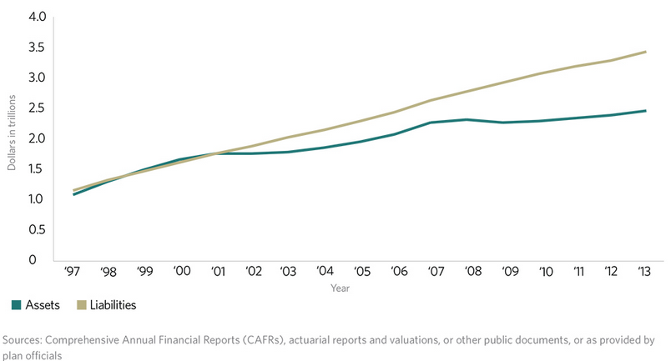
State Pension Funding Gap

Slide 23
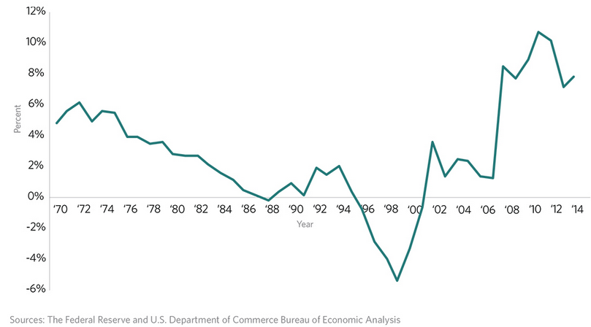
State and Local Pension Debt as a Share of Gross Domestic Product

Slide 24
Alaska: Biggest Reserves as Share of Operating Costs
FY 2015 (Estimated)
Days
FY2011:
1001.2 days
FY2015:
298.6 days
RECESSION
RECESSION
FY 2001 | FY 2003 | FY 2005 | FY 2007 | FY 2009 | FY 2011 | FY 2013 | FY 2015 (estimate)
Notes:
Among all states, the one that could run the longest on reserve funds alone is Alaska. At the end of fiscal 2014, the state had $13.9 billion – or 692.0 days worth of operating expenses – in reserves….Almost 2 years’ worth. That is not even counting Alaska’s permanent fund, which pays dividends to residents as well as saves for the future when the state’s oil reserves are depleted.
But the state’s cushion has fallen in each year since fiscal 2011 because of budget pressure caused by declining crude oil revenue. Lawmakers drew down about a third of the state’s rainy day funds to shore up retirement accounts and cover a budget shortfall in fiscal 2015. Still, Alaska’s reserves still were expected to cover almost 300 days’ worth of spending in fiscal 2015, based on estimates, more than any other state.

Slide 25
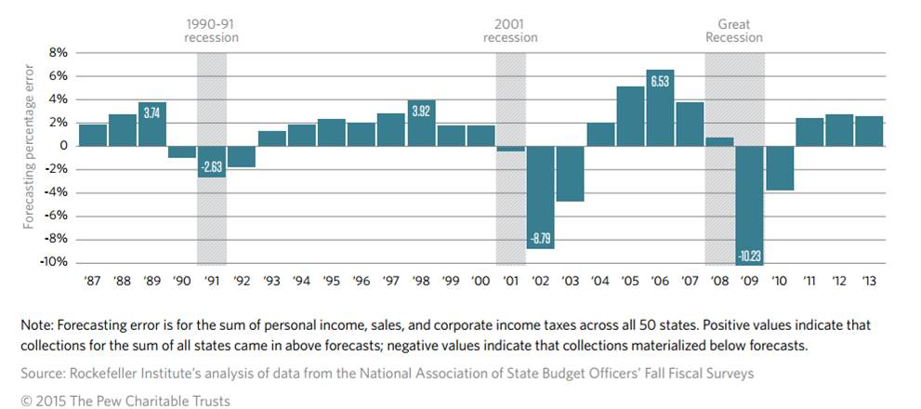
Revenue Forecasting Errors Are Growing
Notes:
Talking Points: “Managing Volatile Tax Collections in State Revenue Forecasts”
State tax collections are harder to predict than ever. This growth in forecasting error is driven by increased revenue volatility. From 2000 to 2013, revenue volatility increased in 42 states.
From 1987 to 2013, the median revenue forecast error was 1.5 percent, meaning half of the state estimates were either 1.5 percent too high or too low.
The forecasting errors of the last two recessions (2001 and 2007) were larger than those in the 1990 recession.
Forecasting errors are larger during and after recessions. The largest error we found was a 10.2 percent overestimate in 2009, the worst year of the Great Recession. Between 1987 and 2013, there were three periods in which officials severely overestimated tax collections, and each was related to a recession: 1990-91, 2001, and 2007-2009.
Less populated states and those dependent on a few economic sectors for their tax revenue tend to have larger percentage errors than larger or more economically diverse states. This may reflect the fact that smaller state economies may be more easily dominated by one or a few industries that may cause significant year-to-year swings in revenue.
Of the taxes examined in this study, corporate income taxes are most difficult to estimate. Over our 27-year study period, the median forecasting error rate was 2.8 percent for the corporate income tax, compared with 1.8 percent for the personal income tax and 0.3 percent for the sales tax. Of these three tax sources, corporate taxes make up the smallest share of state revenue, while personal income makes up the most.
The most volatile component of personal income taxes is capital gains. This is largely contingent on an unpredictable stock market and investor behavior that is difficult to calculate.
The sluggish recovery from the Great Recession has led to weaker-than-usual growth in sales tax revenue in some states. This change to a typically reliable revenue source has compounded forecasting errors.
Changing the mix of taxes in a state does not necessarily improve the accuracy of revenue forecasts. While such tax changes may help control revenue volatility, they complicate the revenue forecasting process in the short run.
With any new tax, it takes several years to compile enough data on receipts to understand the factors affecting revenue strength or weakness. Until forecasters have those observations in hand, they may have little evidence to use in fine-tuning their estimates of how much revenue tax law changes will raise or cost.
Also, state tax systems are complicated and a tax change to lesson volatility may have positive or negative impacts on the adequacy, fairness, simplicity, or economic competitiveness of the system.

Slide 26
Most Accurate Revenue Forecasts are Done Close to Budget Enactment
Number of weeks of the forecast is completed before the start of the fiscal year
Start of Fiscal Year
Notes:
The timing of forecasts can affect accuracy. The longer the time between the forecast and adoption of the state budget, the less accurate revenue estimates will be. The accuracy of a revenue estimate worsens by more than a percentage point for the second year of a biennium and about a half a percentage point for every 10 weeks of lag between the time a forecast is prepared and the start of a forecast period. These phenomena can be eased by states adjusting their estimates carefully during the second year of the biennium, but not all states are sufficiently prudent.
Recommendations:
While no state can completely eliminate forecasting errors, policymakers can better manage volatile revenue by designing an effective rainy day fund. These funds act as a buffer against unexpected shocks by replacing lost revenue from shortfalls and unexpected expenses. In this way, states can rely less on cuts in spending and tax increases. Healthy reserves also can help keep borrowing costs down because credit rating agencies view them favorably when they rate state debt.
Tie deposit rules to volatility
Analyze fluctuations in revenue through regular studies
State officials should prepare and update revenue forecasts as close as possible to the start of the budget year. Many states update forecasts as close as possible to the start of the fiscal year, which is a sensible practice because it gives officials more timely information about spring income tax collections. This does not solve the problem completely, since it only provides information about timely returns. Extensions, typically filings of upper income individuals, also can produce surprises for state tax collections.
State revenue estimators should regularly analyze forecasting errors and sharpen revenue forecasting techniques and assumptions to reflect changing economic conditions. Reasonable economic assumptions often change, and forecasters should factor those into their estimates.

Slide 27
Are States Saving Enough?
State shortfalls outstripped savings nearly 2 to 1
entering the Great Recession
Notes:
States will never be certain exactly how much revenue they will receive in any given year, which complicates the budget process.
Volatility makes it harder to accurately forecast revenues and craft balanced budgets.
There is no easy fix to this problem, and we acknowledge that. However, in the course of our research, we have observed that some states may be able to improve the accuracy of their revenue forecasts by timing them closer to the final passage of the state budget

Slide 28
Days that States Could Run on Reserve Funds
FY 2015 (Estimated)
Days
FY2007:
41.3 days
FY2013:
33.1 days
FY2015:
20.5days
RECESSION
RECESSION
FY 2001 | FY 2003 | FY 2005 | FY 2007 | FY 2009 | FY 2011 | FY 2013 | FY 2015 (estimate)
Notes:
Pew calculates – using NASBO data – how long each state could run on its state’s general fund reserves – counting both rainy day funds and end of year balances – as a simple way to compare states.
As this trend line for the 50-state median shows, state governments tapped their reserves after both recessions this century to help absorb some of the shock of plummeting revenues .
Since the Great Recession, states have made some progress in rebuilding their financial cushions. Compared with a median of 41.3 days’ worth of operating expensesin reserve in fiscal 2007, states’ had a median of 25.9 days worth in fiscal 2014 and an estimated median of 20.5 days in fiscal 2015.
But amounts in both years represent declines from fiscal 2013. These declines were caused by a dip in general fund ending balances, which are sensitive to year-to-year changes in revenue and spending. Meanwhile, states’ rainy day funds have generally grown.

Slide 29
Massachusetts:
Reserves as Share of Operating Costs
FY 2015 (Estimated)
Days
FY2012:
22.4 days
FY2015:
11.8 days
RECESSION
RECESSION
FY 2001 | FY 2003 | FY 2005 | FY 2007 | FY 2009 | FY 2011 | FY 2013 | FY 2015 (estimate)
Notes:
Kil, I’ve added this slide on MA in place of the one on the state with the smallest reserves because I thought it was more relatable to your audience.
Massachusetts financial cushion could cover 45.9 days’ worth of operating costs in fiscal 2007, just before the recession.
After falling in the recession, MA slowly built back its reserves. By the end of fiscal 2012, the state had 22.4 days worth of operating expenses in reserve. However, these levels have fallen in the past three fiscal years as the state has used rainy day funds to help balance the budget.

Slide 30
States with Biggest Reserves
Excluding Alaska
FY 2014
Notes:
Nationally, after Alaska, these states had the greatest financial cushions measured as days of operating expenses at the end of fiscal 2014. (Wyoming, North Dakota, Nebraska, West Virginia). Alaska’s reserves could run its government for 692 days. Notice that these are states where the economy is heavily based on minerals or agriculture.

Slide 31
States with
Smallest Reserves
FY 2014
Notes:
At the other end of the spectrum, four states had less than six days’ worth of reserves on hand: Arkansas, Pennsylvania, New Jersey, Illinois, and Kentucky.
**Again, Arkansas sets money aside, but routinely reports zero reserves to NASBO because of the way they interpret the survey.
You can see your state’s ranking – along with whether it is above or below the 50-state median at Fiscal 50.

Slide 32
12 States Link Deposit Rules with Volatility
Notes:
Here are the 12 states that currently link deposits to volatility in some way.
None of them have rules that are exactly the same, and some have worked better than others. Virginia, for example, has a deposit rule that considers both historic and recent revenue growth, and which has worked particularly well to ensure deposits are made when money is available, but which doesn’t require deposits be made in weak years. On the other hand, Texas has a rule that sets aside a share of growth in its severance tax on oil and gas above the level of a certain year – in this case, 1987. While this rule has resulted in large fund balances, it has at times required deposits be made when broader economic and revenue conditions are otherwise unfavorable, which is not ideal.
If you don’t see your state highlighted on this map, it fits into one of four other categories of states that don’t tie deposits to volatility – there are 21 states that use some determination of year-end fiscal position, five that consider forecast error, 8 that make deposits on an ad-hoc basis or based on static requirements, and four that don’t have any sort of budget stabilization fund that meets our definition.

Slide 33
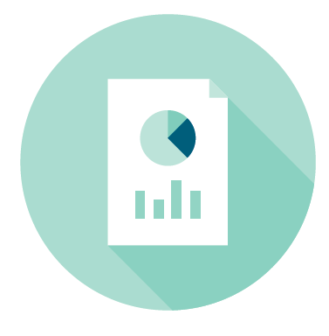
Deposit Rules Designed with Volatility in Mind
Methods used by states to identify and set aside extraordinary revenue growth
Virginia
Tennessee
Idaho
Washington
Hawaii
5 States
Tie to Overall Revenue Volatility
Notes:
Among those twelve states that have deposit rules designed with volatility in mind.
Five states link deposits to overall revenue volatility (Virginia, Tennessee, Idaho, Washington, Hawaii)

Slide 34

Deposit Rules Designed with Volatility in Mind
Methods used by states to identify and set aside extraordinary revenue growth
Massachusetts
Louisiana
Texas
Alaska
4 States
Tie to Particularly Volatile Revenue Streams
Notes:
Four states link deposits to certain volatile revenue sources (Texas, Massachusetts, Louisiana, Alaska)

Slide 35

Deposit Rules Designed with Volatility in Mind
Methods used by states to identify and set aside extraordinary revenue growth
Arizona
Indiana
Michigan
3 States
Tie to Economic Conditions
Notes:
Three states link deposits to economic conditions, a major contributor to budget volatility (Arizona, Indiana, Michigan)
As I noted, none of these states link savings to volatility in exactly the same way, and there is no one-size-fits-all solution for states. Moreover, some of these rules work better than others, with saving during times of growth as the measure of success.

Slide 36
Missed Opportunity: South Carolina
Potential rainy day fund deposits based on a rule like Virginia’s
Notes:
So, we asked the question, how would a deposit rule tied to volatility, like Virginia’s, work in states that don’t have similar policies in place? In the report we provide three examples of what a stronger deposit rule would have accomplished, in Florida, Pennsylvania, and South Carolina. Right now I’ll walk you through our analysis of South Carolina.
Like many other states, South Carolina has a rainy day fund, and a deposit rule that does not look to volatility in the state’s economy or revenues.
During this time, South Carolina built up a balance of $168 million in this fund, which took them up to the statutory limit they had on the fund’s size at the time.
Over the Great Recession, South Carolina had to address a total of $4 billion in budget gaps.
So we asked, what kind of position would South Carolina have entered the Great Recession if they’d had a different rainy day fund deposit rule in place?
In the case of South Carolina, a deposit rule tied to volatility would have resulted in savings of $835 million, nearly five times as much as what they actually had heading into the last recession.
While that’s less than a quarter of the budget gaps they faced over the course of the downturn, if South Carolina had those savings in hand, it would have provided the state considerably more flexibility in their budget response.
This analysis is just intended to demonstrate the approximate scale of missed opportunities for states to save over the mid-2000s, not to make specific policy recommendations.
We recognize that the choice to save is not easy, and doing so often at the cost of other budget priorities
But over the long run, however, the tough choices states make in good times can prevent them from having to make even tougher ones during bad times, when residents may be least able to absorb the impact of tax increases or cutbacks in spending.
Linking savings to volatility is smart because it prioritizes savings when it makes sense to do so, and doesn’t require contributions during lean years
But RDFs are not the only mechanism states have at their disposal. States have a great deal of discretion and flexibility and here are some other examples of how they’ve used that.
Using capital budgets as a budget stabilization tool
State fiscal policy tends to be pro-cyclical due to constitutional requirements that most states must balance their operating budgets. But most states face no such constraint on their capital budgets. Capital budgets can thus be used to provide states with more fiscal flexibility to adopt a less pro-cyclical—and potentially even a counter-cyclical—fiscal policy. This can be done by changing how capital projects are paid for, relying more on tax revenues during growth period and debt issuance during recessions.
For the most part, state policymakers do not think of their capital budgets as a way to smooth volatility across their states’ experience of the business cycle, and there are no state policy frameworks in place that require states to make decisions about capital projects and financing in light of the state’s larger economic and fiscal condition. Accordingly, in the aggregate, the share of state capital investment paid for with debt remained fairly stable over the course of the recession, according to NASBO data from 2007 to 2014.
However, there appear to be several examples of states—Illinois, Iowa, New Hampshire, South Dakota, and Utah—that are following a counter-cyclical capital debt strategy even absent a policy framework to encourage the practice. We examine two below, along with a third (North Carolina) that has expressed interest in countercyclical capital debt policies.
Utah
Utah’s Legislative Fiscal Analyst Jonathan Ball told us that Utah implemented a counter-cyclical capital debt strategy over the last recession. Specifically, starting in 2011 they redirected tax revenues from capital investments to operating budget shortfalls, and shifted the source of funding for capital projects over to debt issuance.
NASBO data illustrate the result of this strategy. Between 2007-2010, about 3% of capital investments were paid for with debt issuance, with the other 97% paid with state tax revenues or federal grants (in fact, 100% of capital investments were paid out of revenues or federal grants in just 2010). But by 2011, that number rises to over 20%, and to nearly a third by 2012.
Illinois
Like Utah, Illinois appears to have shifted how it pays for capital budgets in the last recession. Between 2007 and 2009, it used debt issuance to pay for roughly 13% of its capital investments. That figure nearly doubled in 2010, and has not dropped below 40% since 2011.
We are currently working with our Illinois contacts to identify whether this data trend was the result of an overarching policy direction or not.

Slide 37
Key Takeaways
Most states are still not recovered from the recession when it comes to:
  Tax revenues
  Reserves and balances
Federal belt-tightening will trickle down to the states, where federal funds had provided a 50-year high of $1 of every $3 in state revenue.
States should study volatility and use that information to inform rainy day fund policy – such as redesigning funds so that deposits are tied to observed volatility or establishing fund size targets that match the state’s experience with volatility.
Strategic use of other emergency measures.

Slide 38
Federal Budget Deadlines 2015
Upcoming Federal Budget Deadlines
January 20, 2015: State of the Union.
February 2, 2015: President’s FY2016 Budget Submission Due
February 27, 2015: Homeland Security Funding Expires
March 15, 2015: Current Debt Limit Suspension Expires
April 15, 2015: Budget Resolution Deadline
May 31, 2015: Highway Trust Fund Authorization Expires (extended)
July 1, 2015: Export-Import Bank Expires
July 31, 2015: Highway Trust Fund Authorization Expires (extended)
September 30, 2015: Federal Fiscal 2015 Ends (likely short-term Continuing Resolution). This is also the expiration date for authorization of many programs under the Higher Education Act, the most recent internet access tax moratorium, payments in lieu of taxes (PILT), funding for the Temporary Assistance for Needy Families (TANF), and authorization for the supplemental nutrition benefits program for women, infants, and children (WIC) (Short Term CR)
October 30, 2015: Highway Trust Fund authorization expires
November 5, 2015: Treasury’s extraordinary measures (debt limit) to be exhausted
December 11, 2015: Short-term FY2016 Continuing Resolution expires
December 31, 2015: Deadline for retroactive renewal of tax extenders

Slide 39
Kil Huh khuh@pewtrusts.org
pewtrusts.org/fiscal-health

Slide 40
New York State
Model for Responsible Budgeting

Slide 41
State Operating Funds
FY 2016 First Quarterly Update- $94.2 Billion

Slide 42
Budget Development Goals
  In developing budget options, we have two principal goals, which are related but distinct.
    Eliminate the budget gap to achieve and maintain budgetary balance.
    Adhere to a self-imposed 2 percent State Operating Funds spending cap which has existed since FY 2011.
  Other goals include:
    Maintain or enhance existing rainy day reserve fund balances.
    Take long-term view of budget year decisions.
    Maintain statutory caps governing the allowable level of spending growth in the State’s two largest programs – School Aid and Medicaid.
    Hold agency operational spending flat.
    Use one-time resources for one-time investments in infrastructure, economic development and risk management.
    Control and target new borrowing to keep debt service affordable and within the State’s debt limit.

Slide 43
43
State Spending Growth and Personal Income
(Percent Average Annual Change)
* For the first time in modern history, spending growth is substantially lower than the State’s personal income growth.

Slide 44
School Aid and Medicaid:
Maintains Cap to Long-Term Growth
    Pre-2012 Problem: The State’s two largest spending programs, School Aid and Medicaid, projected to grow at unsustainable rates and contributing to large State deficit in outyears. Average annual growth in School Aid and Medicaid was projected at 9.1 percent and 8.4 percent, respectively.
    Solutions:
Index Medicaid growth to the long-term average growth in the medical component of the CPI (estimated in the range of 3.3 percent over the forecast period) with Executive powers to institute sweeping cost controls to stay within caps, subject to Federal approvals.
  Actual average annual Medicaid Growth in FY 2012 through FY 2015 = 3.5 percent.
  Index School Aid (school year basis) growth to annual increase in NYS personal income (estimated in the range of 4.5 percent over the forecast period).
    School Years 2014, 2015 and 2016 approved increase above indexed rate.
    Actual average annual School Aid Growth from 2012 through 2015:
      3.2 percent (SFY Basis) and 4.1 percent (SY Basis)

Slide 45
FY 2015 Financial Projections
Comparison to Initial (Jan. 2011) Projections
45
(millions of dollars)
Baseline is for State Operating Funds spending. Internal estimates as of January 2011.
Available resources include tax receipts, miscellaneous receipts, and net financing sources from other funds.
Excludes designated fund balances.

Slide 46
46
Average Daily Balances Have Improved Since 2010
(millions of dollars)
FY 2010 reflects daily balance activity from June 1, 2009 through March 31, 2010.
FY 2015 monetary settlement resources are reserved for infrastructure projects and other one-time costs.

Slide 47
FY 2016 Budget Achieved Goals:
    Included a $316 million deposit in FY 2015 to the State’s rainy day reserves, the maximum amount allowable under the deposit calculations at that time.
    Increased the allowable rainy day reserve fund balance and annual deposits to permit reserves to grow up to 7 percent of General Fund spending.
    Prudent use of windfall from settlements with financial institutions for one-time investments in infrastructure and upstate revitalization, a reserve for risks (Federal OPWDD disallowance), limited operating purposes, and other resources yet to be allocated.
    Generally holds personal service and non-personal service spending flat. Workforce levels stable.
    Maintains cap to the long-term growth in the largest areas of the budget – School Aid and Medicaid.
    Authorized a new multi-year property tax credit and extended an existing property tax relief program for New York City residents (qualified homeowners and renters) for an additional four years.
    Continued the phase-in of a business tax reduction plan.
    Controls and targets new borrowing to keep debt service affordable and within the State’s debt limit. Reserves resources for debt management.

Slide 48
Multi-Year Financial Plan
NYS prepares a multi-year Financial Plan that is updated quarterly during the fiscal year. The Financial Plan translates the “budget” into a fiscal plan.
The Financial Plan serves as the State’s official disclosure information in bond offerings. Thus, it must comply with Federal securities law.
  Director attests to accuracy and completeness for each bond sale.
  Insulates Financial Plan from political “spin” and ensures objective presentation.
Financial Plan includes extensive voluntary reporting to enhance financial disclosure to legislators, investors, and general public.
  Multi-year estimates updated quarterly.
  Monthly cash-flow projections updated quarterly.
  Workforce by agency; impact of budget on localities; risk assessment.
  All Funds summaries for all major functions/revenue categories.
  New York ranked #2 in the nation by the non-partisan Federal Funds Information for States (“FFIS”) for making State finances more understandable through the use of comprehensive budget documents, strong reporting practices, and the use of multi-year forecasts.

Slide 49
Monitoring of Budgetary Risks
Managing Federal uncertainty, including Federal actions needed to raise the debt ceiling and avert a shutdown, and the State’s ability to secure long-term Federal funding (i.e., approaching expiration of Highway Trust Fund).
Strength and duration of economic recovery analyzed and forecasted.
Legislative response to the budget and cost of negotiated changes.
Transaction risks (use of fund balances, Federal approval, disaster assistance reimbursement, authority payments, and implementation).
Bond market uncertainties (i.e., market conditions, Federal tax laws).
Monitoring litigation against the State and managing resources to address litigation in the case of an adverse decision against the State.

Slide 50
Debt Burden Steadily Declining
(Percent of Personal Income)
Projected
State debt as percent of NYS personal income

Slide 51
A Responsible Budgetary Reserves Policy
51
  Increased Rainy Day Reserves balance cap from 5% to 7% of General Fund spending, as well as annual deposit authority.
  Made three deposits to rainy day reserves (FY12 = $100 million; FY14 = $175 million; and FY15 = $316 million) since start of global financial crisis and set aside $500 million for debt management.
    Balances total $2.3 billion – highest level since inception of reserves.
    $1.8 billion Rainy Day Reserves (2.9 percent of FY 2015 General Fund
    spending) and $500 million for debt reduction.
  Avoided use of rainy day reserves during fiscal downturns. Reserves remain available in case of increasing revenue volatility or other financial challenges in the future.
  Over $5.4 billion in monetary settlement resources largely reserved for capital investments ($4.6 billion) and other one-time purposes (OPWDD Federal Settlement $850 million) as is appropriate for such one-time resources.
  Legislation to spend settlement money authorizes unspent capital resources to be used in the event of an economic downturn or natural (or man-made) disasters.

Slide 52
Rainy Day Reserves ($ in billions)
Percent General Fund
Note: New York rainy day reserves include the Tax Stabilization Reserve Fund and the Rainy Day Reserve Fund.
Notes:
Reserves, as a share of spending, are currently at their highest level since the 1960s, when the State was rated AAA.

Slide 53
January 2011-August 2015 – Growth in Private Employment
New York’s early recovery from the recession and strong private sector job growth rank the State 6th in growth over the most recent 56 months of available data, relative to the comparable preceding period.
The State has added 700,000 jobs over this period.

Slide 54
A Record of Fiscal Accomplishments
54
  Eliminated the $86 billion (January 2011 estimate) combined five-year General Fund budget gap
  (FY 2012 through 2016).
  Enacted five consecutive on-time budgets with few changes from Executive proposal.
  Balanced these budgets with spending controls and tax reforms, and without fiscal gimmicks such as deficit bonds/notes, use of rainy day reserves, major asset sales, etc.
  Recorded surpluses in FY 2014 and FY 2015 -- first since FY 2007.
  Total State debt declined for three consecutive years, which has not occurred since the 1960s.
  Implemented tax cuts and reforms that are intended to provide property, business, and estate tax relief. Through FY 2016, these changes result in cumulative taxpayer savings of over $30 billion since the Governor took office.
  Reached labor deals that have yielded significant wage and benefit concessions.
  Enacted a pension tier for new employees as of April 1, 2012 which is expected to save the State $21 billion and localities $61 billion over 30-year period.
  Held agency spending nearly flat, continuing redesign efforts and reflecting savings from wage and benefit concessions agreed to by the State’s largest unions.

Slide 55

Commonwealth of Massachusetts
Presentation to MAGNY:
The Massachusetts State Budget
October 9, 2015
Dominick Ianno
Chief of Staff / Communications Director
Massachusetts Executive Office for Administration and Finance

Slide 56
Overview
        Introduction
        Budget development process
        Challenges
        Managing the budget
Notes:
56
This is a seasoned team that was able to get its arms around the FY15 and FY16 budgets so quickly because we have worked together for this Governor in this office on the budget in the past. We are conservative budgeters with a general approach to under-promise and over-deliver on the budget.

Slide 57
Introduction
The new Administration has assembled a seasoned and experienced staff of public finance professionals:
  The new Governor is a former HHS Secretary, A&F Secretary, health care CEO and consultant. During his previous tenure at A&F, the Commonwealth received upgrades from each of the rating agencies in the 1990s.
  Of the seven senior members of new team at Administration and Finance, five served previously at A&F. The two others senior members have significant budget experience serving in senior budget leadership positions in the Legislature.
  The new A&F team includes staff that were formerly:
    A business-group health care expert
    The CFO of a highly-rated top 50 municipal issuer
    A&F Deputy Budget Director and private sector consultant
    A Senate Ways and Means Budget Director
    A municipal bond lawyer
    A Fortune 50 corporate affairs director
    Former Deputy Director of the Commonwealth’s health insurance agency
Notes:
57
This is a seasoned team that was able to get its arms around the FY15 and FY16 budgets so quickly because we have worked together for this Governor in this office on the budget in the past. We are conservative budgeters with a general approach to under-promise and over-deliver on the budget.

Slide 58
Introduction
The Commonwealth of Massachusetts has many positive fiscal and credit elements
  A collaborative, bi-partisan relationship between the Governor, Legislature, and Treasurer
  A diverse economy led by growing industries that supports high per capita incomes
  Strong K-12 school system
  A well-trained workforce that results from an education system that consistently leads the nation
  Strong financial management and rapid response to fiscal shortfalls
  Consistently conservative tax revenue forecasting
Notes:
58
The Commonwealth has a strong economy and strong education system that spur innovation jobs that deliver high levels of income.
The state uses sound fiscal management practices starting with conservative tax forecasting.
We still have a healthy Stabilization Fund and, as evidenced by our rapid response to the FY15 deficit, we address problems quickly.

Slide 59
Budget Development Process
  Fiscal Year runs July 1 – June 30
  Consensus Revenue Hearing: early December
  Consensus Revenue Adoption: early January
  House 1 (Governor’s Budget): last week of January
  House Budget: April
  Senate Budget: May
  Conference Report: June
  Budget enacted: July 1
  A&F Revenue Review: October 15
Notes:
59
We identified the FY15 problem less than two weeks into office.
We reached out to you right away.
We implemented 9C cuts and filed legislation to fix the $768 million gap we identified two weeks later.
The Legislature enacted the bill, almost in its entirety ten days after that.
This was the first example of the kind of the bipartisan collaboration we have in the state.

Slide 60
Challenges
  Managing spending growth to keep in line with revenue
  Reliance on one-timers
  Revenue Volatility (i.e. Capital Gains)
  Managing “Budget Busters” (i.e. Medicaid)
Notes:
60
We identified the FY15 problem less than two weeks into office.
We reached out to you right away.
We implemented 9C cuts and filed legislation to fix the $768 million gap we identified two weeks later.
The Legislature enacted the bill, almost in its entirety ten days after that.
This was the first example of the kind of the bipartisan collaboration we have in the state.

Slide 61
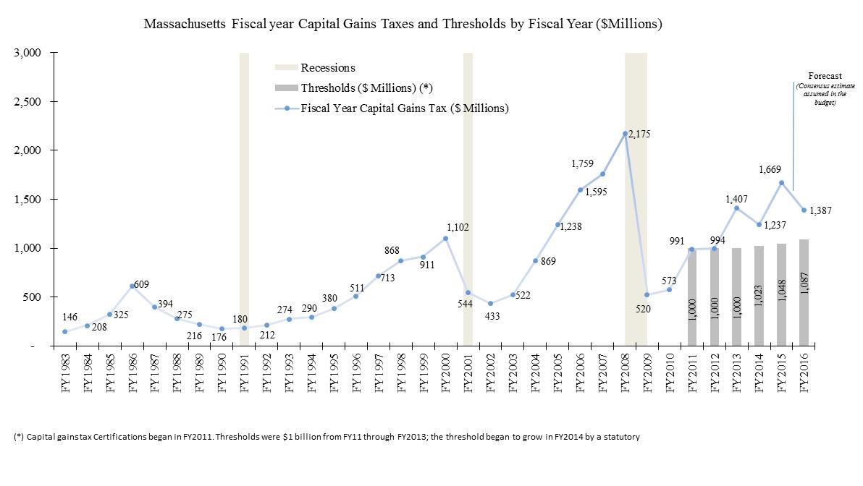
Challenges: Capital Gains Collections

Slide 62
Challenges: State Spending, FY10-16
5.1 % Compound Annual Growth Rate
CAGR
by sector, FY10-16
7.5%
4.7%
7.9%
2.4%
3.5%

Slide 63
Challenges: Medicaid Historic Spending
(in billion $s)
Notes:
Overall 2.6% local aid increase
Funds increase of $20 per pupil and 45% equity

Slide 64
Challenges: Medicaid Historic Spending
(in billion $s)
Notes:
Overall 2.6% local aid increase
Funds increase of $20 per pupil and 45% equity

Slide 65
Managing the Budget
The Commonwealth is committed to addressing fiscal problems quickly, restoring structural balance and replenishing the Stabilization Fund
Short-Term:
  Hiring and Regulatory Freeze
  Bringing spending in line with revenue while funding key priorities: education, local aid, transportation, DCF, etc.
  Reviewing Agency missions and performance
  Business Process Redesign
  Regulatory Review Process
  Maintaining pension and OPEB liability funding
Notes:
65
In the short-term, given the size of the problem, we took immediate steps to get our fiscal house in order.
This required balancing FY15 in the five months we had left without doing deeper into the Stabilization Fund.
It also required holding the line on spending next year while continuing to fund our liabilities.

Slide 66
Managing the Budget
Long-Term:
  Establish a stable business climate
  Fast-track permitting and reduce regulatory burden
  Restore structural balance
  Re-build the Stabilization Fund
  Address long-term liabilities including OPEB
  Fix the Connector
  Fix the MBTA
  Managing Medicaid growth and bend the health care cost curve
Notes:
66
Over the longer-term, we need to improve the climate for job and business creation and growth.
We need to achieve structural balance through management improvement and reforms and address health care and OPEB costs.

Slide 67
Questions
Q&A

